Slide 1
PHISHING AWARENESS TRAINING
CodeAlpha Cyber Security Internship
Submitted By:
Prachiti Vartak

Slide 2

INTRODUCTION
During my Cyber Security Internship at CodeAlpha, I completed the Phishing Awareness Training project. The purpose of this project was to understand phishing attacks and learn how cybercriminals trick users into sharing sensitive information. Phishing is one of the most common cyber attacks and affects both individuals and organizations.
In this project, I studied different phishing techniques, fake emails, fake websites, and social engineering methods used by attackers. I also learned how users can protect themselves from such attacks.

Slide 3

OBJECTIVES
The main objectives of this project were:
• To understand phishing attacks.
• To learn how phishing emails and websites work.
• To identify warning signs of phishing attempts.
• To study prevention techniques.
• To create awareness about cybersecurity threats.

Slide 4
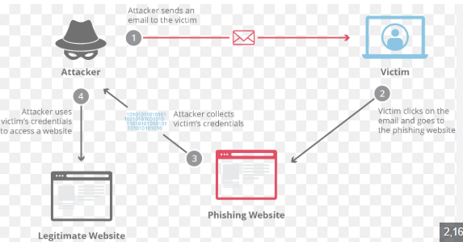
WHAT IS PHISHING?
Phishing is a type of cyber attack where attackers pretend to be trusted organizations and try to steal sensitive information such as usernames, passwords, bank account details, and personal information.
Most phishing attacks are carried out through emails, SMS messages, social media messages, and fake websites. Attackers try to create urgency so that users take action without verifying the authenticity of the message.

Slide 5
TYPES OF PHISHING
Email Phishing - Email phishing is the most common phishing technique. Attackers send fake emails that appear to come from banks, online services, or companies.
Spear Phishing - This attack targets a specific person or organization using personalized information.
Smishing - Smishing is phishing through SMS messages.
Vishing - Vishing is phishing through phone calls where attackers pretend to be officials or support staff.

Slide 6
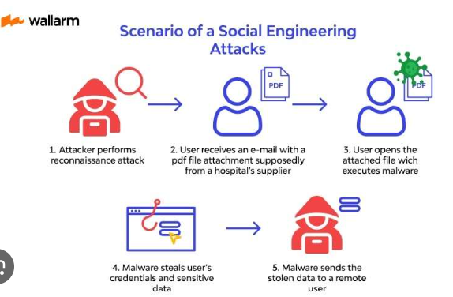
SOCIAL ENGINEERING
Social engineering is a technique where attackers manipulate human behavior instead of attacking computer systems directly.
Some common methods include:
• Creating urgency
• Building trust
• Creating fear
• Offering rewards
These methods make victims more likely to reveal confidential information.

Slide 7
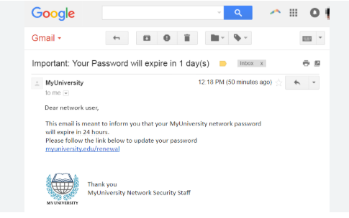
Identifying Phishing Emails
While studying phishing attacks, I found several common warning signs:
• Unknown sender address
• Spelling and grammar mistakes
• Suspicious links
• Requests for passwords
• Urgent action messages
• Unexpected attachments
Users should always verify emails before clicking any links.

Slide 8
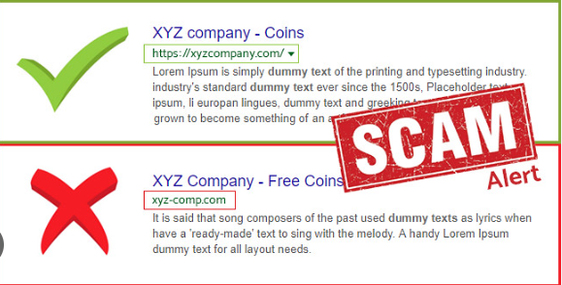
Identifying Fake Websites
Fake websites are designed to look similar to legitimate websites.
Common signs include:
• Incorrect URL
• Missing HTTPS security
• Poor design quality
• Unexpected login requests
• Unrealistic offers and discounts
Users should always verify website addresses before entering personal information.

Slide 9
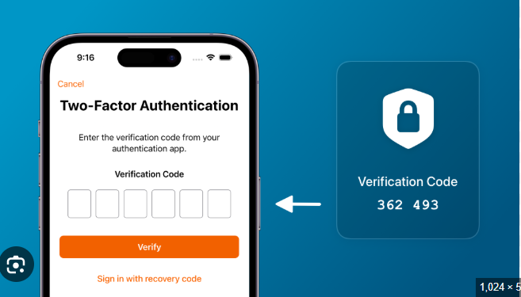
Prevention Methods
To stay safe from phishing attacks, users should:
• Verify sender details.
• Avoid clicking suspicious links.
• Use strong passwords.
• Enable two-factor authentication.
• Keep software updated.
• Use antivirus protection.
• Report suspicious emails.

Slide 10
Learning Outcome
Through this project, I gained practical knowledge about phishing attacks and cybersecurity awareness. I learned how attackers use social engineering techniques to target users and how to identify suspicious emails and websites. This project improved my understanding of cyber threats and online safety practices.

Slide 11

CONCLUSION
Phishing attacks remain one of the biggest cybersecurity threats today. Many successful attacks occur because users are unaware of phishing techniques. Through this project, I learned how phishing attacks work and how users can protect themselves from becoming victims. Creating awareness is one of the most effective ways to reduce phishing-related incidents and improve cybersecurity.

